Slide 1

Title: Harnessing AgroTech module data, machine
learning & IOT for enhanced agricultural productivity.
Team: AgroTech
AgroTech Optimizing Crop Yield and Sustainable solution for Farming.

Slide 2


1. The Overview
Objective: To forecast crop quality and quantity using our Innovative AgroTech Module and Machine learning ,IOT enhancing agricultural sustainability and productivity.
Technology Integration: Utilizes IOT, ML-based app for real-time monitoring of crop data.
Alert System: Ensures proactive monitoring and alerts users in case of issues.
Versatility: Provides high-quality crop suitable for various purposes.
Impact: A sustainable and innovative approach in agricultural Production &Energy conservation.
Accessibility: Tailored for affordability and ease of use in local communities.
Scalability: Designed for easy expansion and adaptation in such a way that customer can access farmers Crop & farmer gets Maximize production
Functionality: Collect, analyze, and visualize weather data to generate predictive insights on crop growth and yield potential.

Slide 3


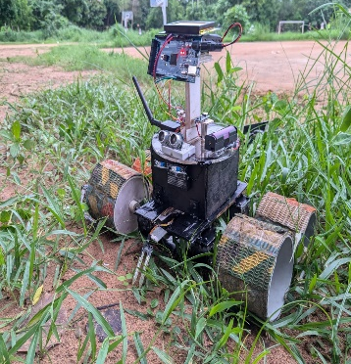
2. The Problem
We are addressing lack of real-time agricultural data for efficient crop management and better yield optimization.
Description of Farmers pain points
Inconsistent yields impacting income.
Limited access to large consumer based market.
High vulnerability to weather-related risks.
Difficulty in predicting optimal planting and harvesting times.
Lack of insights into crop health and potential disease outbreaks.
Consumer Pain
Limited Availability of Local Product.
Lack of Transparency.
Concerns About Pesticides and Chemicals.
Difficulty in Supporting Small Farmers.
Price Sensitivity Inconsistent Product Quality.
Here,
we get you to the AgroTech Innovative & Sustainable Solution.

Slide 4
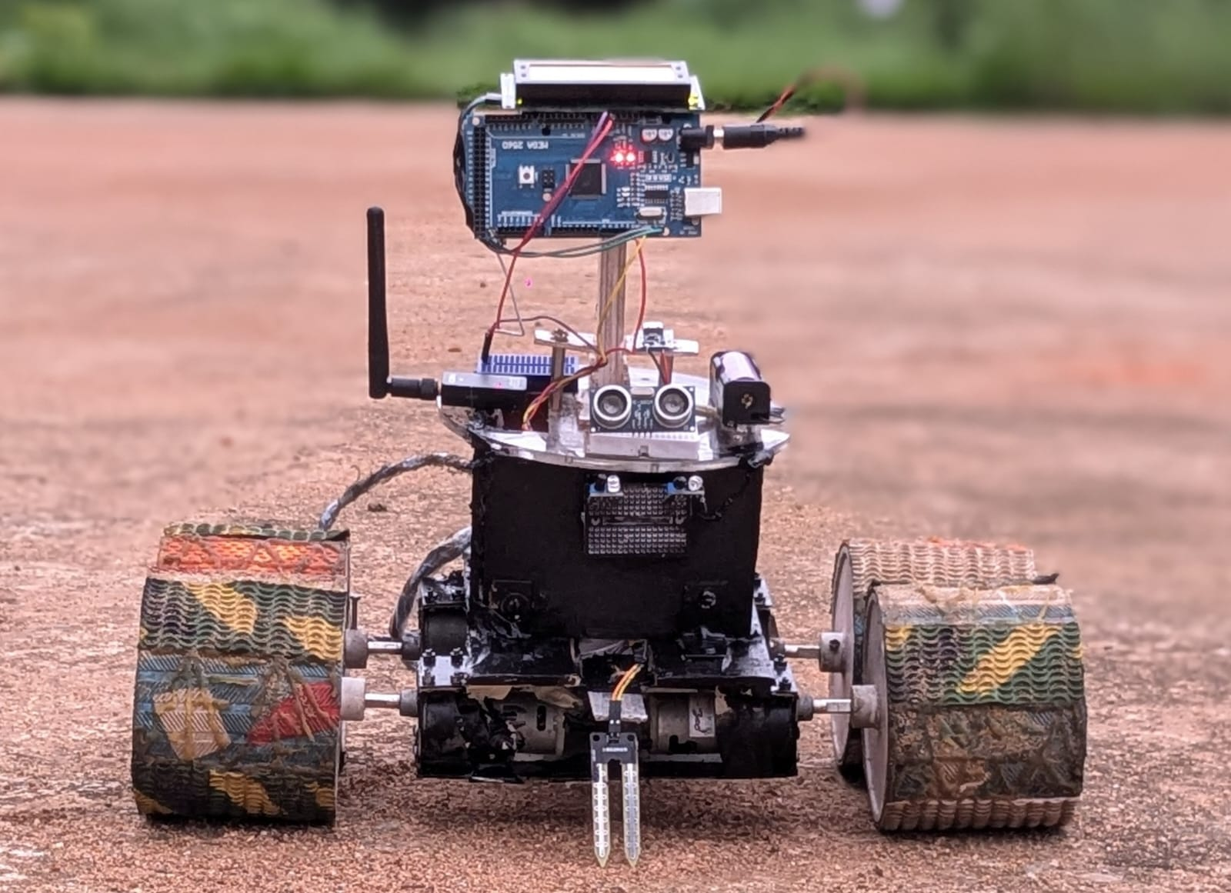
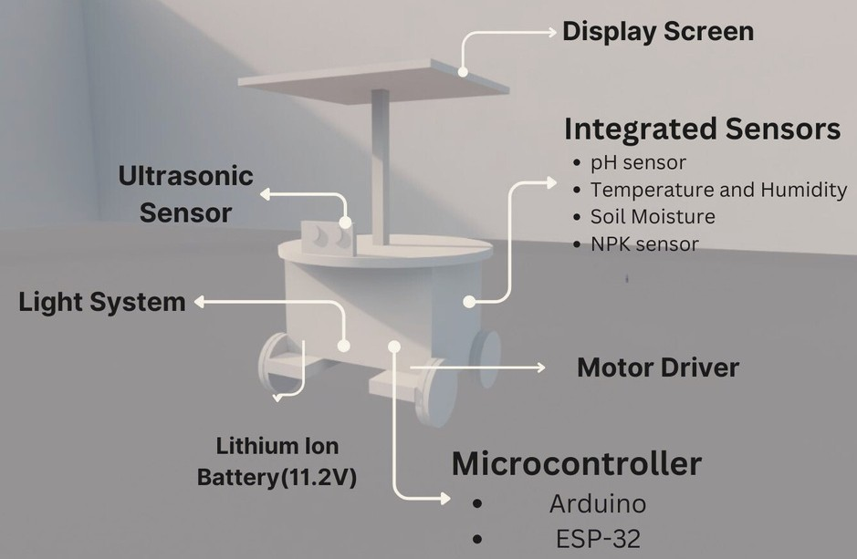

3. The Solution
AgroTech Optimize design to collect data of the land for agricultural yield.
This innovative module integrates various sensors to collect real-time land data, including temperature, humidity, and other key parameters essential for crop growth. Using a Wi-Fi or radio frequency module, the data is transmitted to a mobile app for analysis and prediction.
The app utilizes machine learning algorithms incorporating factors such as temperature, dew point, humidity, precipitation, wind conditions, and more to assess crop conditions and land fertility. Farmers receive actionable insights on crop health, potential yield, and optimal resource management directly on their smartphones, enabling informed decision-making for improved agricultural productivity and sustainability.
Precision Agriculture
IoT-enabled Crop Monitoring
Real-time Sensor Data
Weather Analytics

Slide 5




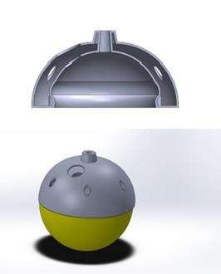




High level Design/Solution Architect
Agricultural land (Collect Data from Land)
Mobile/Web App (Agrotech)
MOBILE APP (AGROTECH)
CONSUMER SIDE
FARMER SIDE
Sensor Network
User Interface Data Visualization Alerts and Notifications Historical Data
Predictive Analytics
Charging Point
Top Part
MVP(Agrotech)
Soil pH Sensor Soil Moisture
Temperature/Humid ity
Light Sensor NPK Sensor CO2 Sensor
Integrated Sensors
Internet/WiFi/LoRa
CLOUD SERVICES
Consumer
FARMERS/LANDS
Consumer
Data Storage (No SQL)
Data Processing Machine Learning API Management
Agrotech
(Land Module)
Data Called
Process
MICROCONTROLLER
Discount/ Organic Farm Products
TRACKING
(Navigation of Consumer)
Data Collection
Data Processing
Local Display
CROP RECOMMENDATION
Crop Health
Yield Maximise Data Output Prediction
Farmer-Consumer Interaction (Communication Layer)
COMMUNICATION
MODULE (WIFI)
CLOUD SERVICES
Data Transformation
Data Storage (No SQL)
Data Processing Machine Learning API Management
DATABASE
Direct Supply (System)
(Transport Base)
No SQL Database

Slide 6
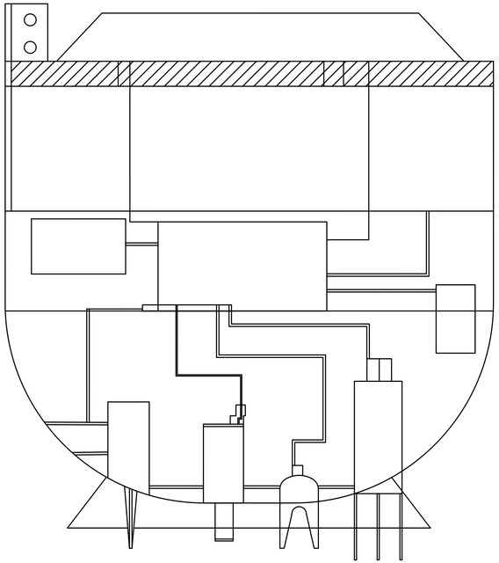



TECHNOLOGY ARCHITECTURE
AGROTECH
Hardware Model
HARDWARE INFRASTRUCTURE
Display
Microcontroller(ESP-32)
Charging Point
IOT FIRMWARE TRANSFER
Soil pH sensor
Moisture sensor
Sensors
Humidity sensor
Battery
Microcontrollers
Display(Screen)
NPK sensor
HTTP
Power Supply(LiPo battery)
GPS
ESP32(WIFI) MODULE
Sensor Module
SOFTWARE INFRASTRUCTURE/ SOFTWARE ARCHITECT
NPK
Sensor
Moisture Sensor
NETWORK & COMMUNICATION CLOUD INFRASTRUCTURE
Agricultural land
Humidity Sensor
pH Sensor
Data Processing Machine Learning Real Time Analytics
Data Storage(No SQL)
UI(User Interface) Data Visualization
Alerts and Notifications Historical Data Recommendation of Crop

Slide 7





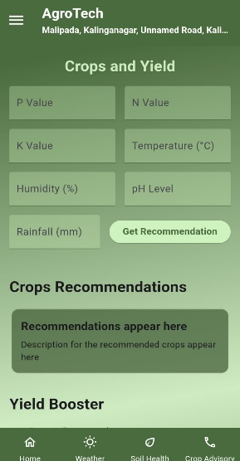
LOW LEVEL DESI GN
Crop Recommendation System
Mobile/Web App
:
(Agrotech)
A. Crop Health Monitoring
Internet/WiFi/LoRa
Communication Layer
A. User Interface:
Data Analysis:
Assess crop health from sensor data.
Detect anomalies using ML models.
Intuitive design, easy navigation for farmers.
Data Transmission:
Transmit data and recommendations to the app with reliable, low- latency communication.
B. Data Visualization
B. Yield Maximization
Cloud Services
Recommendation Engine:
C. API MANAGEMENT
Interactive charts for sensor data and predictions
Recommend planting, irrigation, and nutrient management for yield optimization.
A. DATA STORAGE
API Gateway:
Manage API requests and ensure secure, efficient communication between app and backend.
APP Interface
C. Data Output
C. Alerts and Notifications
NoSQL Database: Store and scale sensor data for analysis and prediction.
Reporting:
Real-time alerts for critical events and reminders.
Generate crop health and yield reports with insights and preventive measures.
Ensure easy data retrieval.
D. Prediction
DATA PROCESSING
Machine Learning:
Apply algorithms to analyze data. Predict crop health, yield, and metrics. Continuously update models with new data.
D. Historical Data
Predictive Analytics:
Access to historical data and trend insights
Forecast crop performance and predict harvest times, yield, and market prices.

Slide 8
Business Model
Investment | Costing
Hardware Components:
- Temperature Sensors: + Moisture Sensors + NPK Sensor + Microcontroller + Communication Module + Central Server = ₹ 8000
2. Development and Implementation:
- Integration and Testing: ₹1000 per unit
3. Server Data Base & Application Costing:
- Installation Costs: = ₹ 1000 per unit.
Total Cost per Unit = ₹ 10,000
Total Operating Income (TOI)
Annual Revenue per User: ₹12,000
Annual Cost per Unit: ₹10,000
Operating Income per User: ₹12,000 - ₹10,000 = ₹2000
Revenue Model
Market Size:
Total Farms: 570 million worldwide
Potential Customers: 5.7 million farms (1% market penetration)
Potential Users: 100,000 users (10% of 1 million)
Annual Spending per User: ₹12,000
Total Serviceable Market (SAM): ₹120 million net revenue
Revenue per Farm: ₹2000 per year (profit)
Total Potential Revenue: ₹2 billion per year (assuming 100% market penetration)

Slide 9

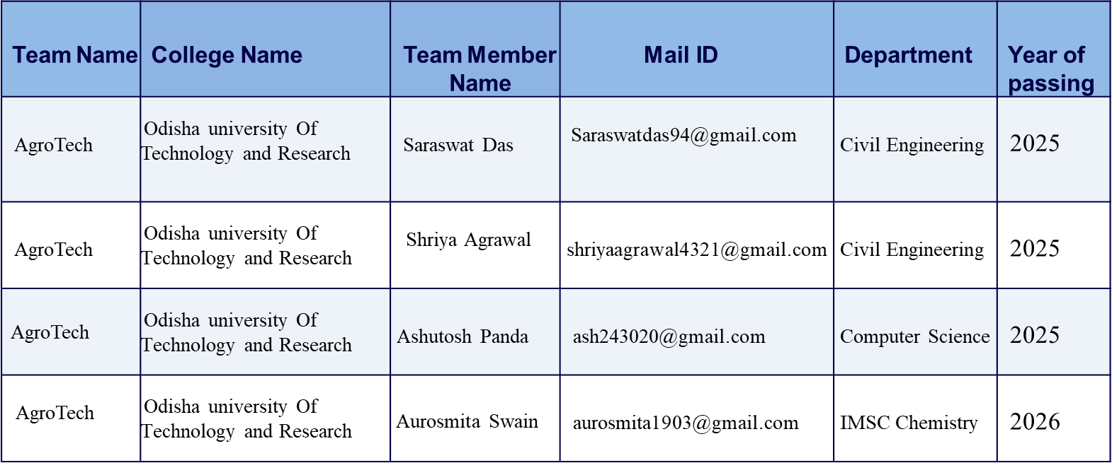


https://github.com/Swayam2004/AgroTech-All-Project-Files

